Slide 1
E343: Week 11 Day 1
VdW Reading p. 204-216, Basic Multiplication & Division Fact Instruction
Notes:
E343: Week 11 Day 1 — Basic Multiplication & Division Fact Instruction
Focus: Building fluency in basic multiplication and division facts through conceptual understanding and strategy instruction (Van de Walle, Chapter 10, pp. 204-216).
Welcome: Begin with a warm greeting. Acknowledge that fact fluency is critical for upper elementary success. Students who struggle with multiplication facts often avoid mathematics entirely. Today, we’ll explore research-based strategies to help all students develop both conceptual understanding and computational fluency.
Key Concept: Today is about teaching multiplication and division as strategies, not memorization through drill. We’ll focus on how arrays, area models, and decomposition help students understand WHY 6 × 7 = 42, not just that it does.

Slide 2
Agenda
Finish Multiplication & Division Problem Types
Analyze instruction of basic multiplication facts
Plan instruction for basic multiplication facts
Notes:
Agenda Overview (5-7 minutes):
1. Finish Problem Types: Briefly review problem structures with unknown in different positions. This scaffolds students’ thinking about how multiplication can be interpreted in context.
2. Analyze Basic Fact Instruction Strategies: Explore strategies like doubling, distributive property, and area models. Reference Van de Walle pp. 204-216 for evidence-based guidance on which strategies to teach first.
3. Plan Your Instruction: Work collaboratively to create a detailed lesson plan (p. 25-29 of packet) showing how you would teach 1-2 multiplication facts using the strategies we discuss.
Timing Tip: Keep this agenda brief; the main work happens in the activities that follow.

Slide 3
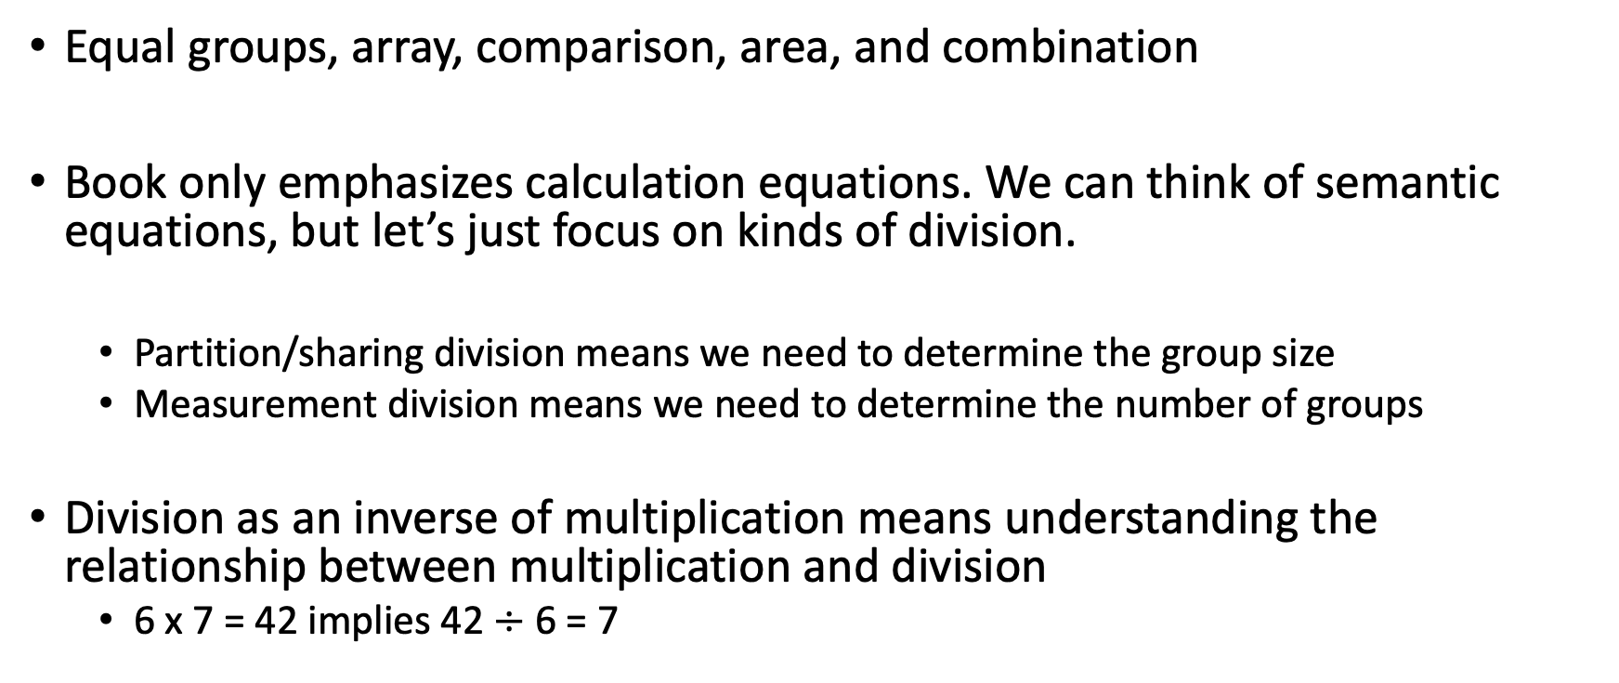
Problem Types and Unknown Parts, Unit 3 Packet P. 18
Equal groups, array, comparison, area, and combination
Book only emphasizes calculation equations. We can think of semantic equations, but let’s just focus on kinds of division.
Partition/sharing division means we need to determine the group size
Measurement division means we need to determine the number of groups
Division as an inverse of multiplication means understanding the relationship between multiplication and division
6 x 7 = 42 implies 42 $÷$ 6 = 7
Notes:
Problem Types and Unknown Parts (3-5 minutes)
Discussion Points:
• Show Unit 3 Packet p. 18 which categorizes multiplication problems by unknown position (product unknown, group size unknown, number of groups unknown).
• Explain: Students need to understand that 4 × 6 and 6 × 4 can represent different real-world situations, even though the answer is the same. This is foundational for division.
• Note: These problem types connect to how students will develop division as the inverse of multiplication.
Pedagogical Tip: Don’t spend too long here; this is context-setting. Move to strategies quickly.

Slide 4
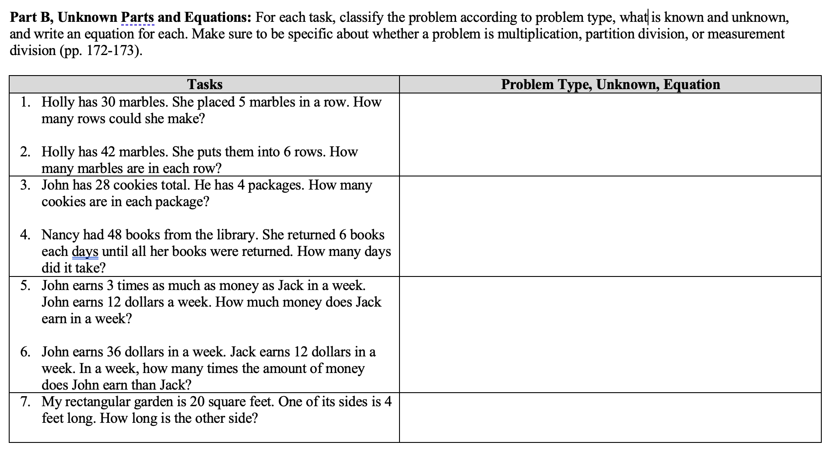
Unit 3 Packet, p. 18
Notes:
Unit 3 Packet Reference (p. 18 screenshot)
What Students See: This slide displays the problem types framework from your course packet. It visually categorizes three types of multiplication situations: product unknown, group size unknown, and number of groups unknown.
Talking Points:
• Point out that product unknown (“6 groups of 7 beans”) is most common in instruction.
• Note that division naturally arises from the other two problem types.
• Reinforce: All three types strengthen students’ conceptual understanding of multiplication.

Slide 5
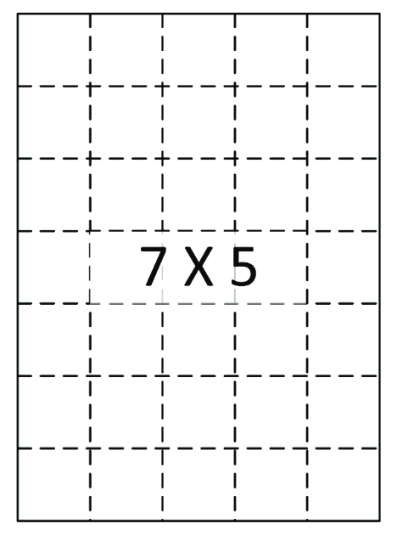
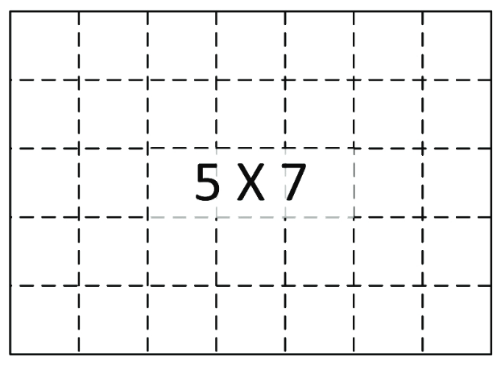
Commutative Property: Area Model
Notes:
Commutative Property: Area Model (VdW Strategy #1)
What is Being Shown: The visual demonstrates that 4 × 6 and 6 × 4 represent the same area when shown as arrays. This helps students see that the order doesn’t change the product.
How to Explain:
“Look at this area model. If we count rows first (4 rows of 6), we get 24. If we count columns first (6 columns of 4), we still get 24. The commu­tative property means we can flip the numbers and still get the same answer. This cuts our basic facts to memorize in half!”
Classroom Application: Show multiple arrays and have students rotate them 90 degrees to see the relationship. This is a powerful early strategy.
VdW Reference: Chapter 10, pp. 206-207. Arrays are one of the first strategies students should explore.

Slide 6
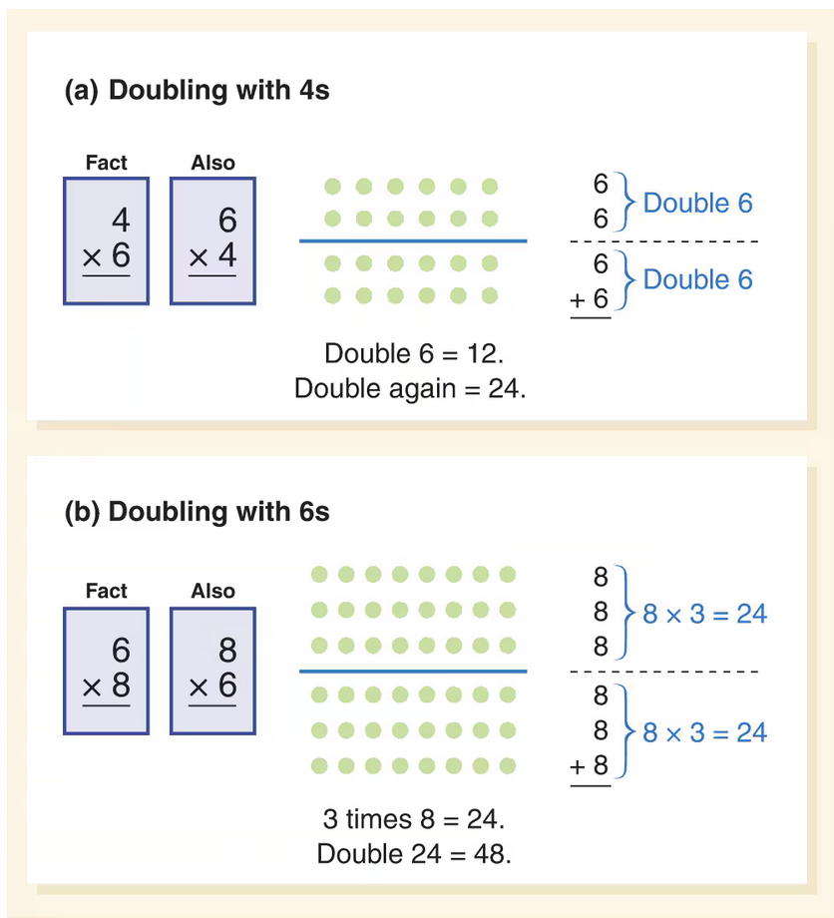
Doubling
Doubling
Notes:
Doubling Strategy (VdW Strategy #2)
The Fact: 8 × 4
Strategy Breakdown:
“Think of 8 as double 4. If I know that 4 × 4 = 16, then 8 × 4 must be double that, or 32. I can use a fact I already know to build a new one.”
Why It Works: If you know all the “square” facts (4×4, 5×5, etc.), doubling one factor gives you instant access to 16 more facts. Reduces cognitive load significantly.
Teaching Tip: Use area models side by side: show 4×4, then 8×4 (which is two 4×4 rectangles stacked). This visual reinforces the concept.

Slide 7
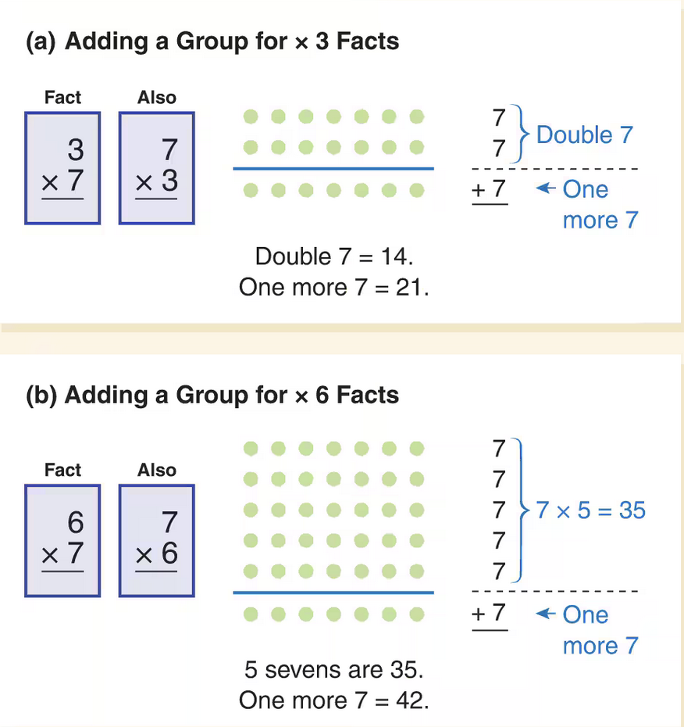
Add a Group (Distributive Property)
Doubling
Adding or subtracting a group
Notes:
Add a Group / Distributive Property (VdW Strategy #3)
The Fact: 4 × 6
Strategy Breakdown:
“I know 3 × 6 = 18. If I add one more group of 6, I get 18 + 6 = 24.”
This is the Distributive Property: 4 × 6 = (3 × 6) + (1 × 6)
Why Students Love It: It feels like a game: “Get to a fact you know, then add more.” Very intuitive and builds confidence.
Timing Suggestion: Use skip counting or quick arrays to verify: “6, 12, 18, 24.”

Slide 8
Making Bases from N101
Five groups of 9
XXX XXX XXX XXX XXX
XXX XXX XXX XXX XXX
XXX XXX XXX XXX XXX
Become 4 groups of 10 and 5 ones
Notes:
Making Bases from N101 (Building Foundations)
The Concept: Five Groups of 9
What This Represents: This slide shows how grouping by fives (a “base 5” model) can help students think about multiplication. Fives are conceptually easier because we have 10 fingers (2 groups of 5).
How to Use in Instruction:
• Use ten-frames or grouped manipulatives to show 5 groups of 9 = 45.
• Connect to skip counting: “9, 18, 27, 36, 45.”
• This strategy especially helps with facts involving 5 and 9.
VdW Connection: Fingers and base structures are foundational tools (p. 208).

Slide 9
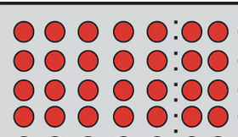
Break Apart (Distributive Property)
Doubling
Distributive Property
Notes:
Break Apart / Distributive Property (VdW Strategy #4)
The Fact: 6 × 7
Strategy: Break the 7 into Smaller Parts
“I can break 7 into 5 + 2. So 6 × 7 = (6 × 5) + (6 × 2) = 30 + 12 = 42.”
Why This Matters: This is another application of the distributive property and is very powerful. IMPORTANT REMINDER (from slide): This is multiplication, not addition! Students often confuse 6 × 7 with 6 + 7.
Common Student Errors:
• Computing 6 × 5 = 30 but then forgetting to multiply 6 × 2; they add instead.
• Confusing the break apart strategy with skip counting.
Visual Support: Use area models: show a 6-by-7 rectangle split vertically into a 6-by-5 and a 6-by-2 section.

Slide 10
Remember: What is a Number Talk?
A simple teaching routine where a teacher gives students a grade appropriate computation task and asks them to mentally figure out
Takes about 10 minutes, can happen daily, works on number sense and computation.
Students are given a few minutes to determine an answer to the problem(s) using a strategy.
Students share strategies, teacher shows student strategy uses a representation, and/or records an equation for student reasoning.
Students use hand signals to participate.
Notes:
What is a Number Talk?
Definition: A number talk is a brief, focused mental math discussion (typically 5-10 minutes) where students share strategies for solving a single problem or set of related problems.
Structure:
1. Present a problem (often just verbally or written briefly).
2. Students think silently (5-10 seconds) — NO calculator, NO pencil.
3. Students share HOW they solved it (not just the answer).
4. Teacher records strategies visually (drawings, equations, number lines).
Why Number Talks Matter:
• Makes thinking visible and value multiple strategies.
• Builds community and confidence.
• Develops mental math and reasoning skills, not just procedural fluency.
Five Practices Connection: This is an excellent structure for the Five Practices (anticipate, monitor, select, sequence, connect).

Slide 11
Let’s do a number talk
A movie theater has 30 seats in each row of its balcony. There are a total of 6 rows in the balcony. The balcony is arranged so there are 10 seats, then an aisle, 10 seats, and then another aisle, and finally 10 seats. Make a picture of the balcony and decide how many seats there are.
XXXXXXXXXX XXXXXXXXXX XXXXXXXXXX
XXXXXXXXXX XXXXXXXXXX XXXXXXXXXX
XXXXXXXXXX XXXXXXXXXX XXXXXXXXXX
XXXXXXXXXX XXXXXXXXXX XXXXXXXXXX
XXXXXXXXXX XXXXXXXXXX XXXXXXXXXX
XXXXXXXXXX XXXXXXXXXX XXXXXXXXXX
Notes:
Let’s Do a Number Talk (8-12 minutes)
The Problem: “There are 30 seats in a row and 6 rows in our movie theater. How many total seats?”
What to Say:
“Think about this problem in your head. Don’t write anything down. How many total seats? Think about HOW you figured it out, not just the answer. Give me a thumbs up when you have a strategy.”
Facilitation Tips:
• Wait at least 10 seconds of silent thinking time before taking responses.
• Call on students with different strategies: skip counting, decomposition, doubling, arrays, etc.
• Draw or write each strategy on the board. Label them: “Jamie’s way,” “Marcus’s way.”
• Ask: “Does anyone else used a similar strategy?”
• Affirm multiple approaches: “I notice everyone got 180, but you got there different ways. That’s the power of strategies!”
What to Watch For: Student struggle often reveals misconceptions (e.g., counting by 30’s vs. multiplying 30 × 6). Use these as teaching moments!

Slide 12
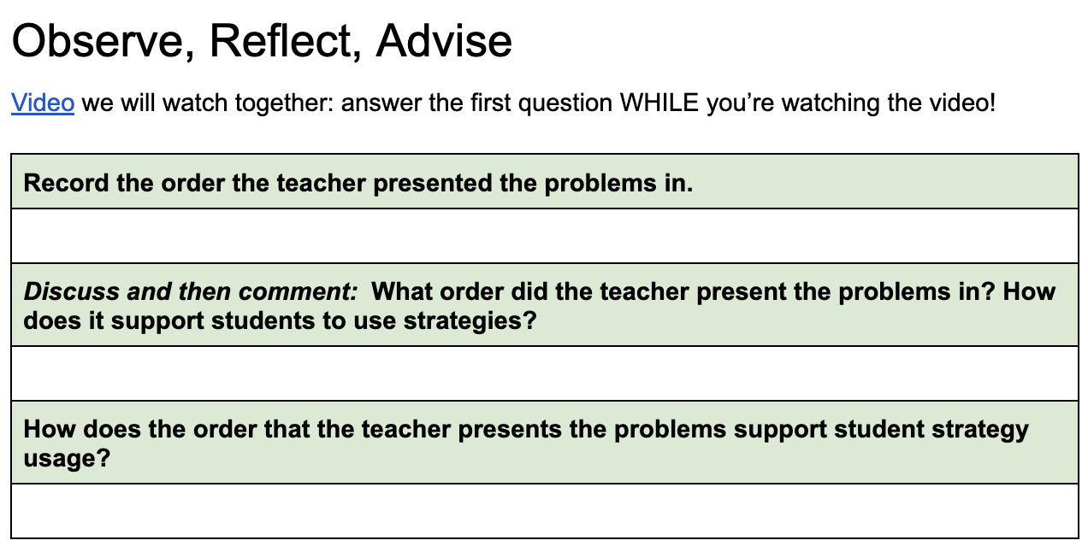
Unit 3 Packet, p. 23 & 24
Video
Notes:
Placeholder notes for slide 22

Slide 13
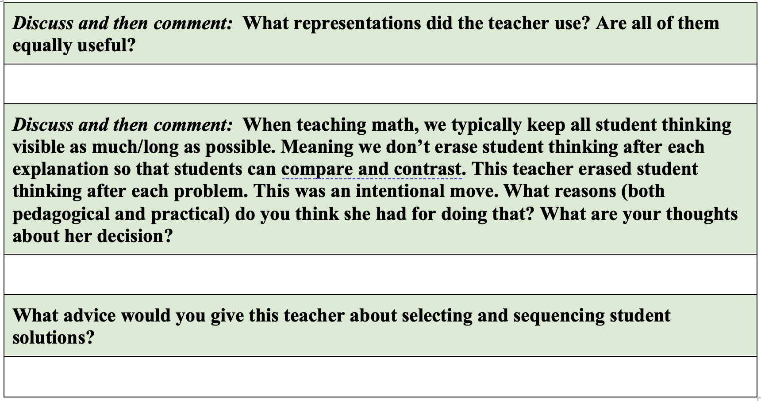
Observe, Reflect, Advise
Video
Notes:
Placeholder notes for slide 23

Slide 14
Create an Instructional Plan Unit 3 Packet, p. 25-29
Notes:
Placeholder notes for slide 24

Slide 15
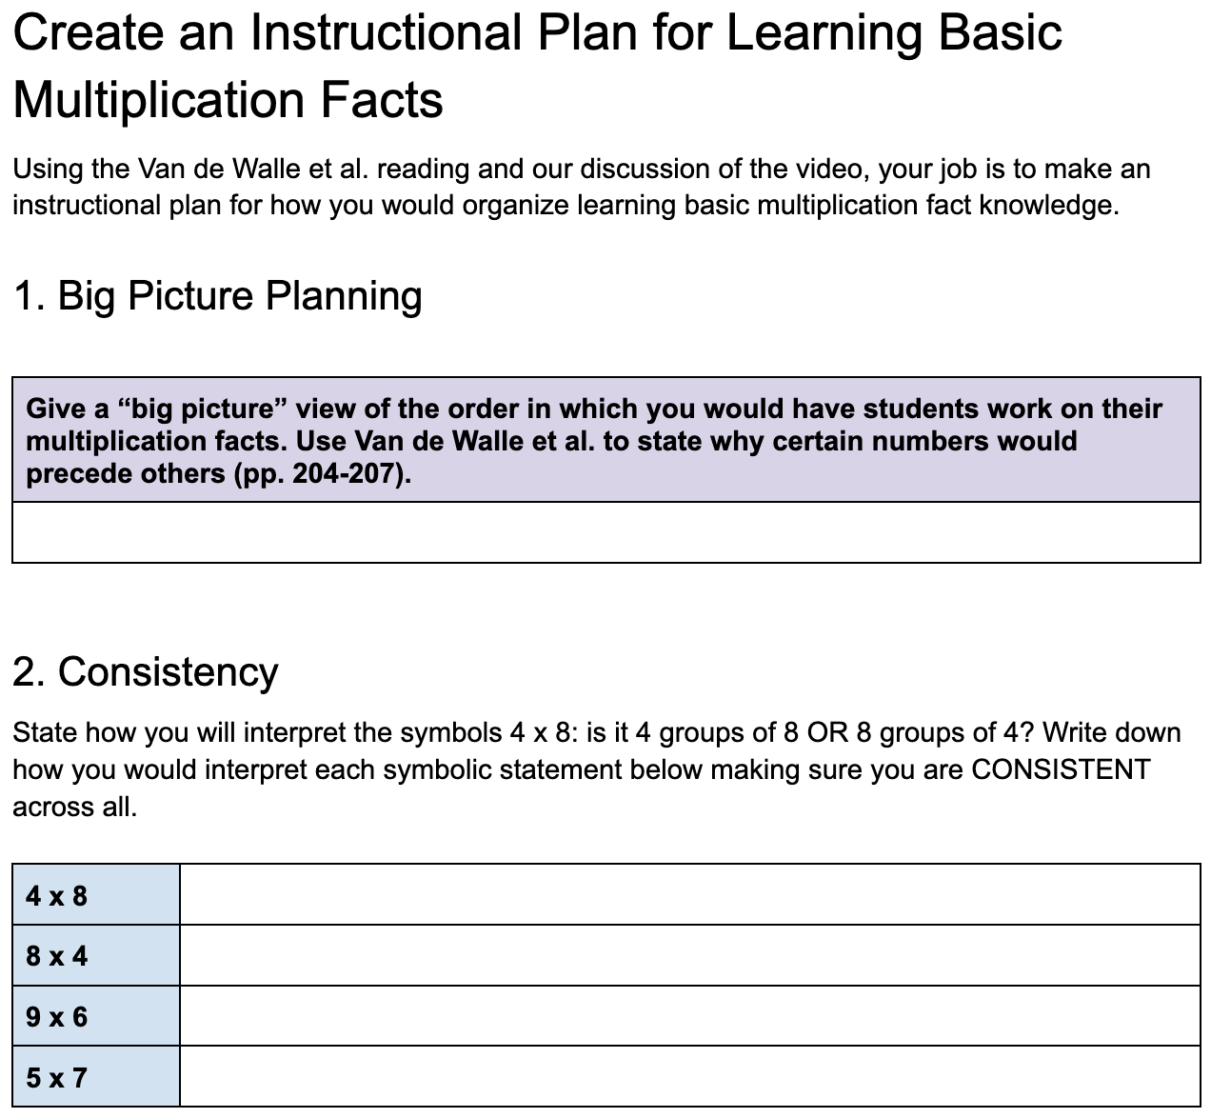
Notes:
Placeholder notes for slide 25

Slide 16
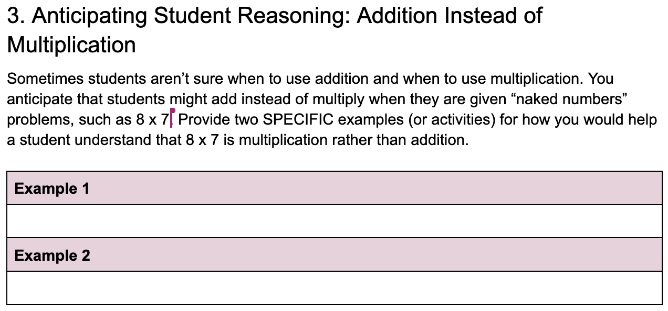
Notes:
Placeholder notes for slide 26

Slide 17
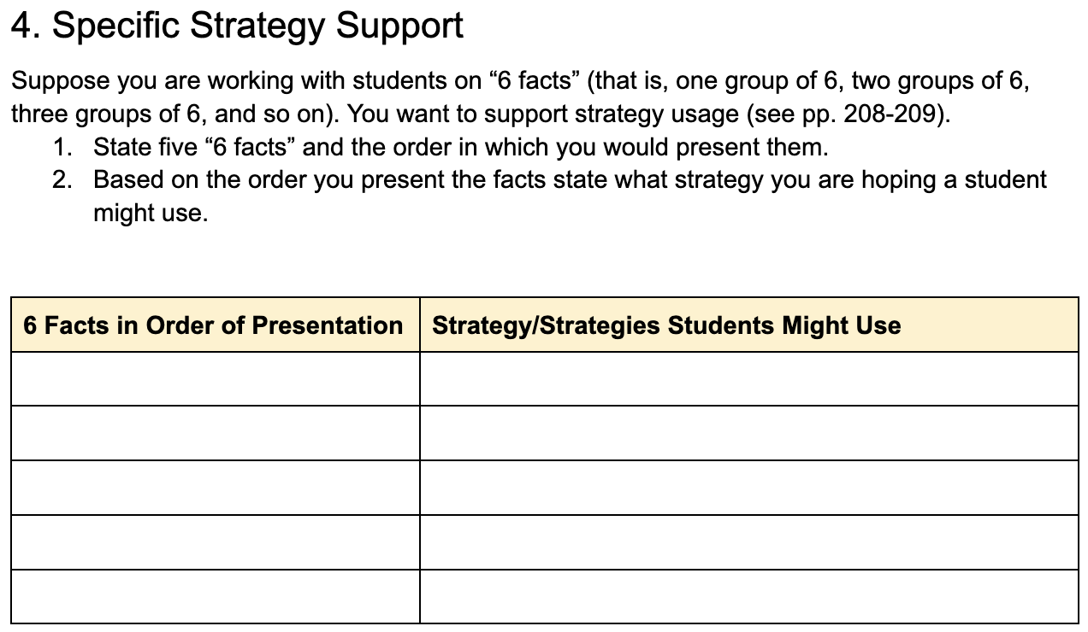
Notes:
Placeholder notes for slide 27

Slide 18
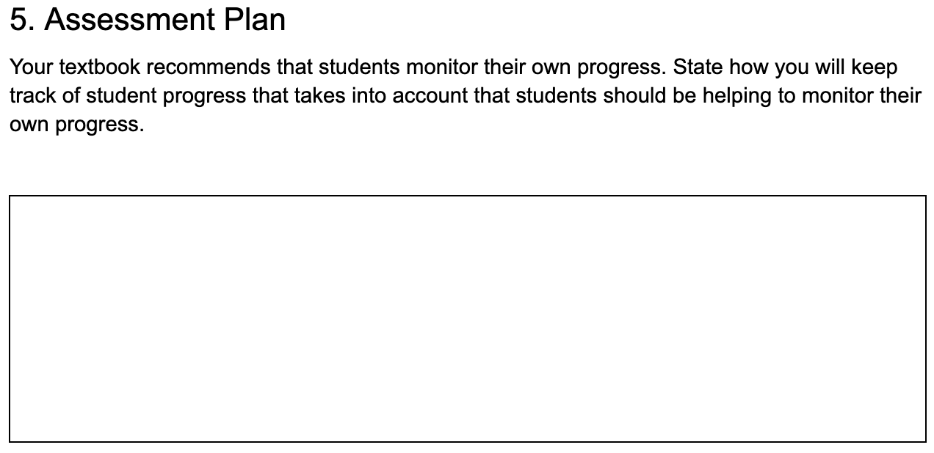
Notes:
Placeholder notes for slide 28

Slide 19
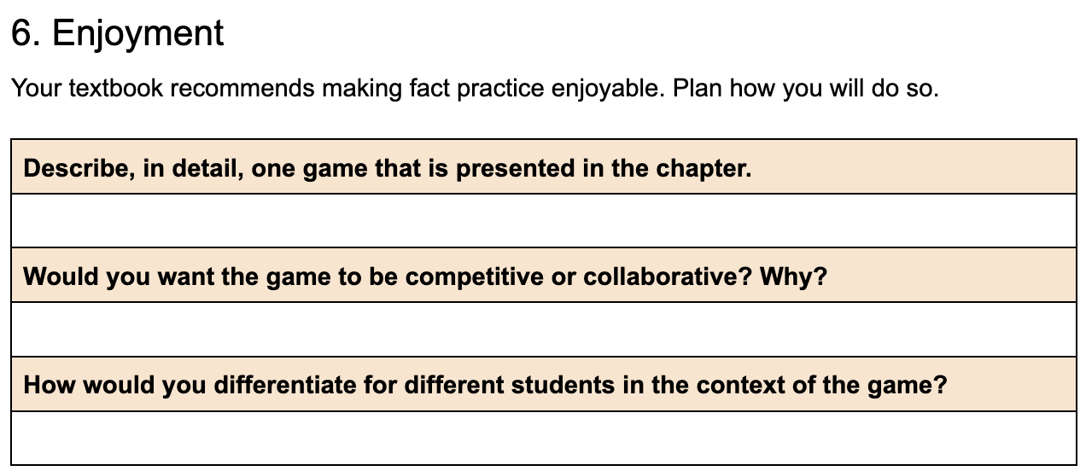
Notes:
Placeholder notes for slide 29

Slide 20
Until Next Time
Reading:
VdW: Multiplication Reasoning Strategies & the Multiplication Algorithm
Grade 3 – 5 vertical articulation (Read 1st)
Lesson Plan 3 Final Draft due Wed.
Lesson Analysis Lesson 2 due Sun.
Notes:
Placeholder notes for slide 30

Slide 21
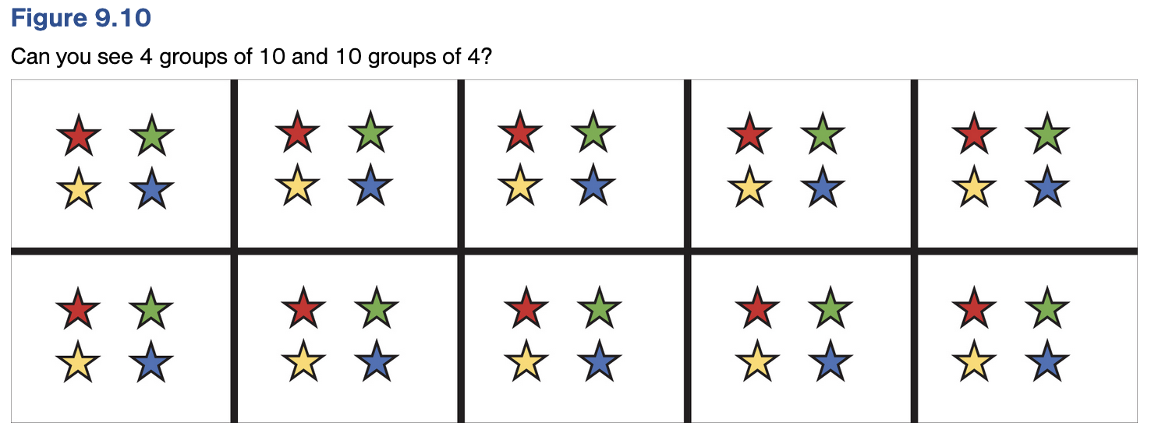
Commutative Property: 10 groups of 4 equals 4 groups of 10
Notes:
Placeholder notes for slide 31

